Slide 1
College Tab
Lakshmi Narain College of Technology, Bhopal
Submitted By:
Anushree Kumar (27)
Ekveera Joshi (44)
Manas Khare (55)
Guide:
Dr. Manish Shrivastava

Slide 2
Table of Contents
01
Introduction
03
Technology Used
02
Existing System
04
Progress
Here we describe what our project aims to provide
Here we refer to the technologies used for the front end and back end
Here we talk about the similar technologies that exist in the market
Here we discuss the percentage of project that is completeed

Slide 3
Introduction
The purpose of College Tab is to create a complete platform where all the activities such as uploading assignments, submitting reports and taking online tests in an efficient manner can take place at once (thereby reducing manual work). The main objective of our project is to create a web application that efficiently evaluates the candidate thoroughly through a fully automated system that not only saves lot of time but also gives fast results.
Scope:
This can be used in educational institutions as well as in corporate world.
Can be used anywhere any time as it is a web based application(user Location doesn’t matter).
No restriction that examiner has to be present when the candidate takes the test.

Slide 4
Existing System
A system that already exists and is currently used by our college as well is LMS. But a lot of students find it to be complex and fail to properly understand it. Along with that the technology also failed to administer the mid semester examinations due to heavy traffic. Solution - College Tab therefore aims to provide a robust alternative that won’t fail under the circumstances of heavy traffic.
Currently we receive most of the assignments on WhatsApp and are expected to submit it via email. For this we have a system known as Accsoft (Assignments can be both uploaded and submitted here).But here the issue that persists is that Accsoft also handles students’ academic reports, attendance, fees etc. Therefore college tries to keep minimum unnecessary data (thereby using LMS). Solution – Thus College Tab will be the optimum alternative for submitting all assignments, reports and conduction of exams.

Slide 5
Technology Used
Back End:
We have used Django for the back end. Django is an open source web application frame work which is written in Python. It proves really helpful to build the complex database-driven websites such as ours.
Front End:
Front end framework is written in HTML, CSS and Bootstrap that makes designing a user interface easily and also ends up being user friendly. HTML is used for structure and presenting content on the world wide web. An HTML document can provide information for browsers such as what style to use and where to get it. CSS is a stylesheet language that enhances the HTML document. Bootstrap is a free and open-source CSS framework directed at responsive, mobile-first front-end web development.

Slide 6
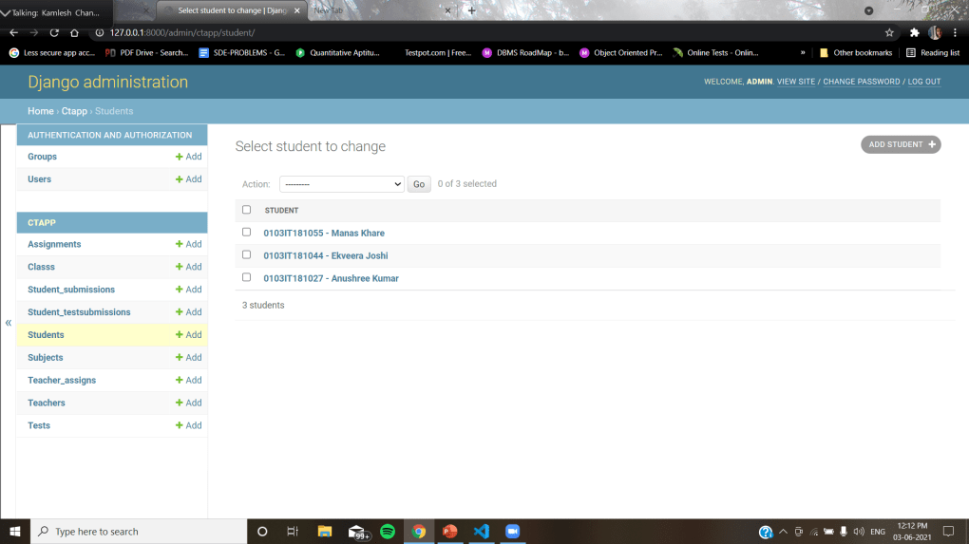

Slide 7
Progress
98% of project is completed.
Some connectivity issues remain which will be resolved in due time.

Slide 8
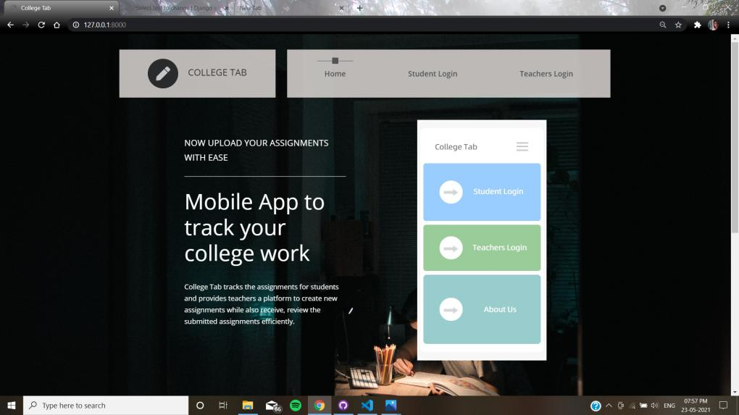

Slide 9
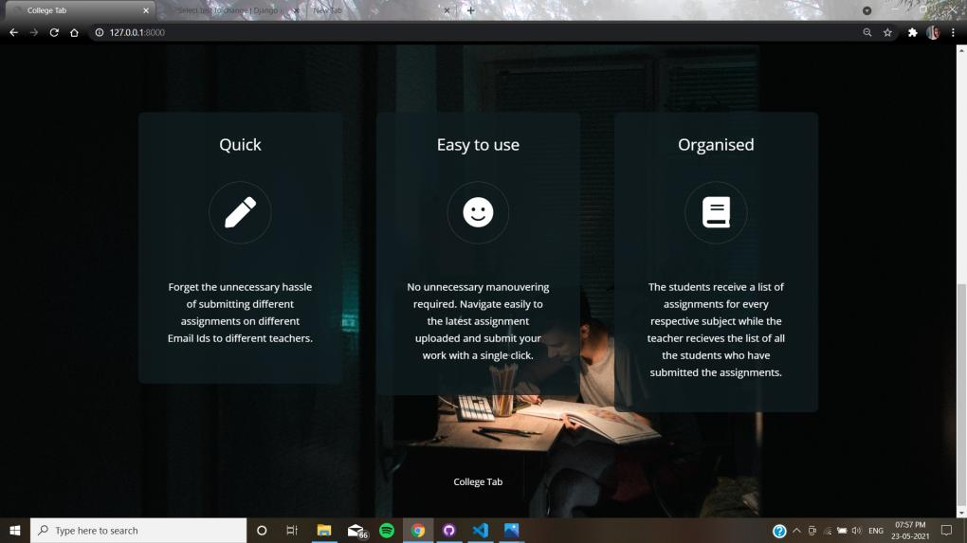

Slide 10
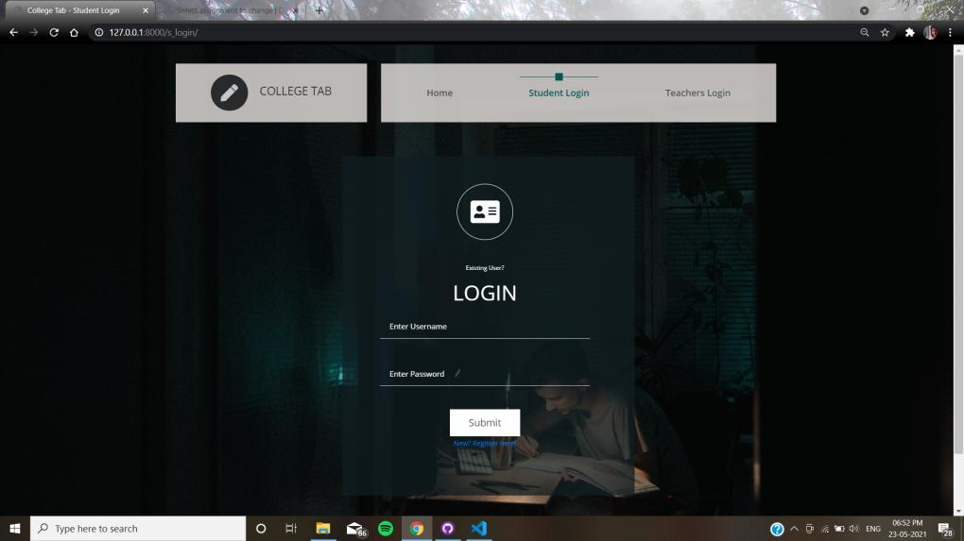

Slide 11
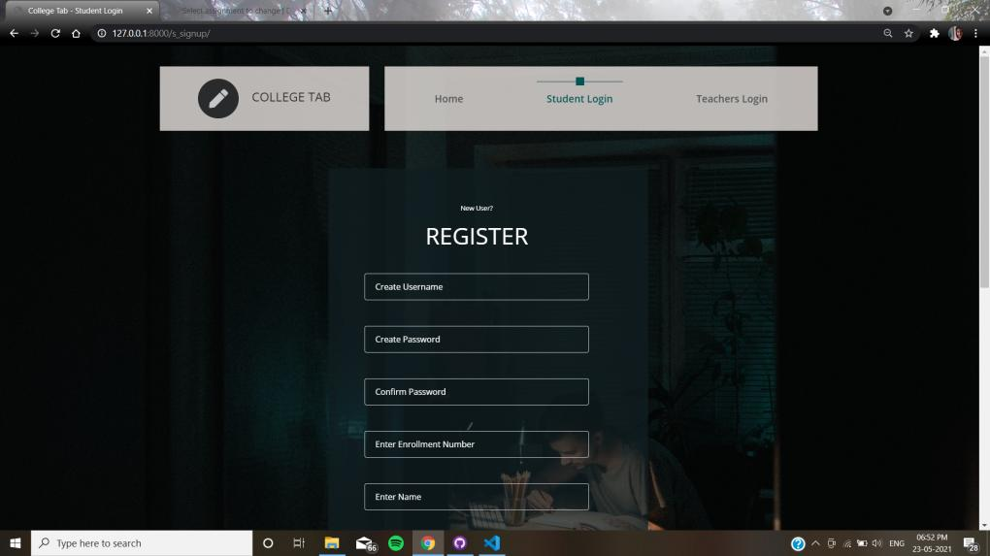

Slide 12
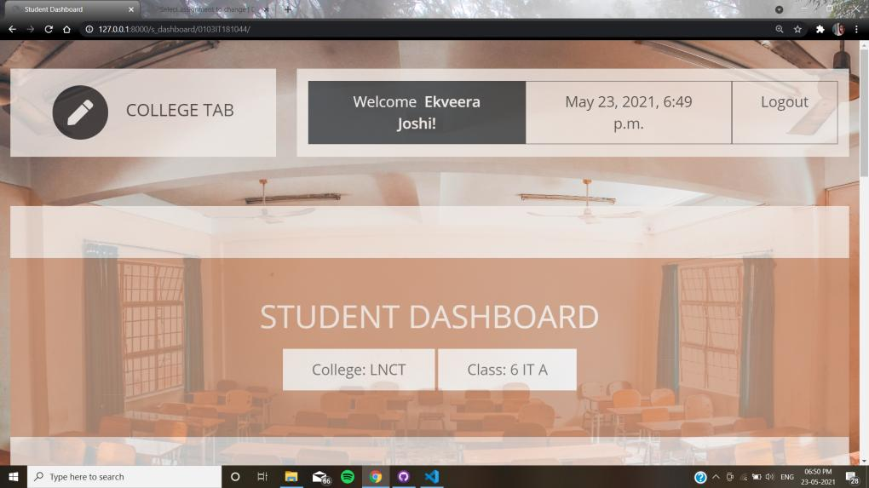

Slide 13
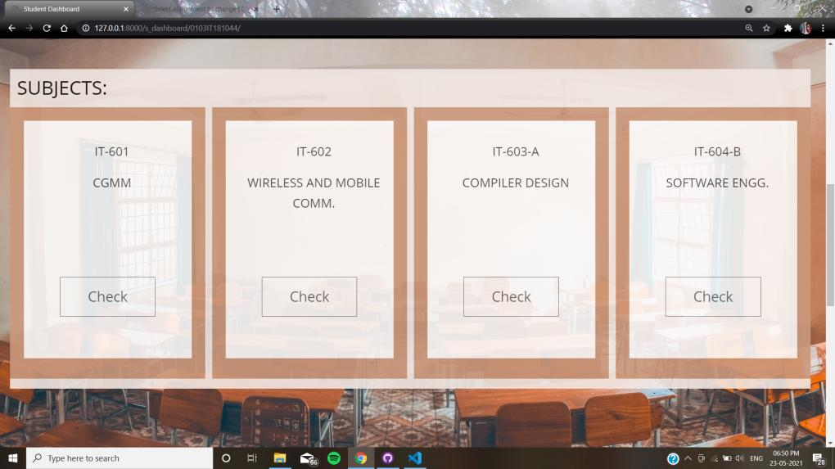

Slide 14
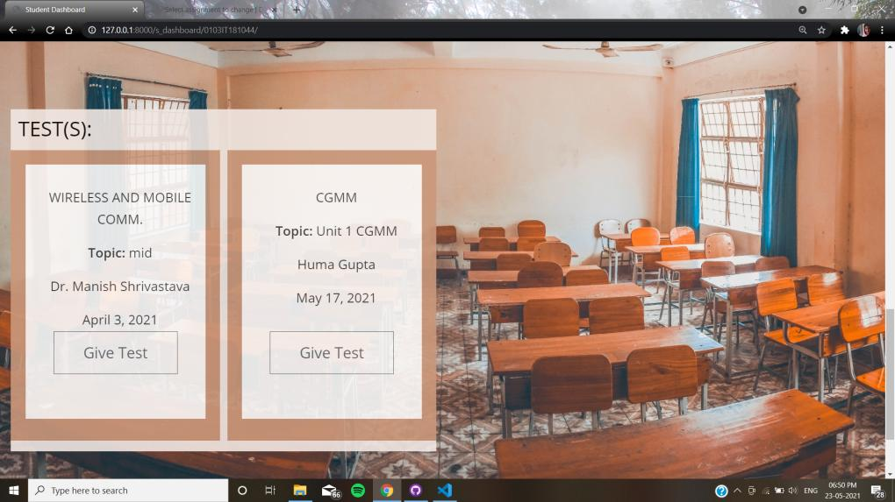

Slide 15
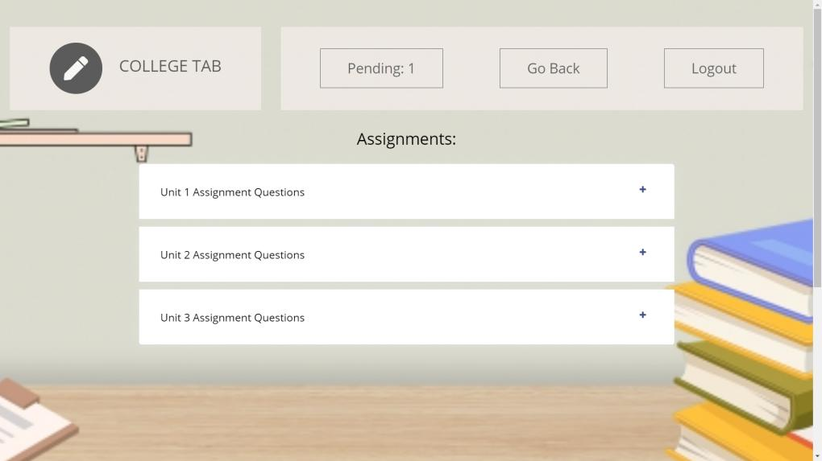

Slide 16
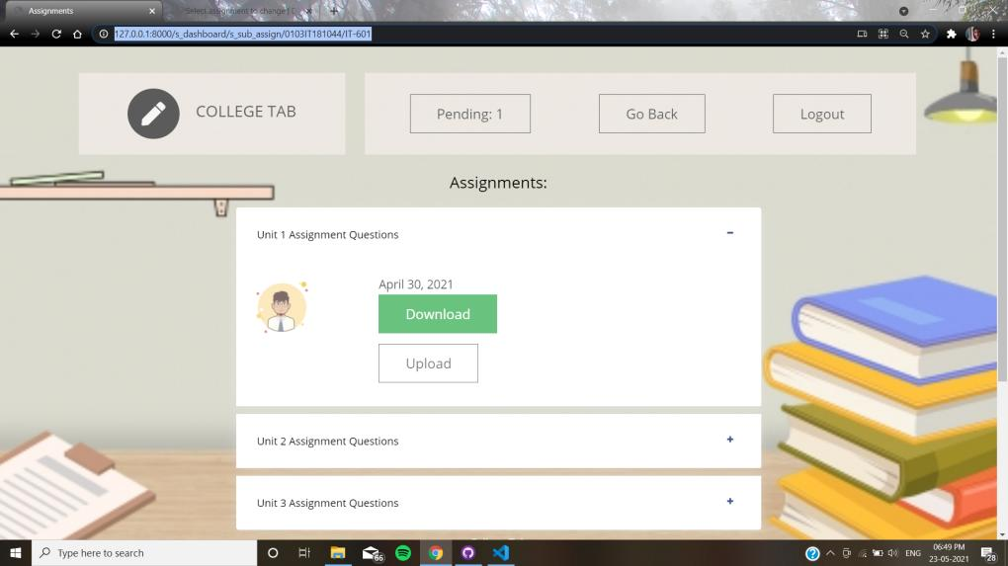

Slide 17
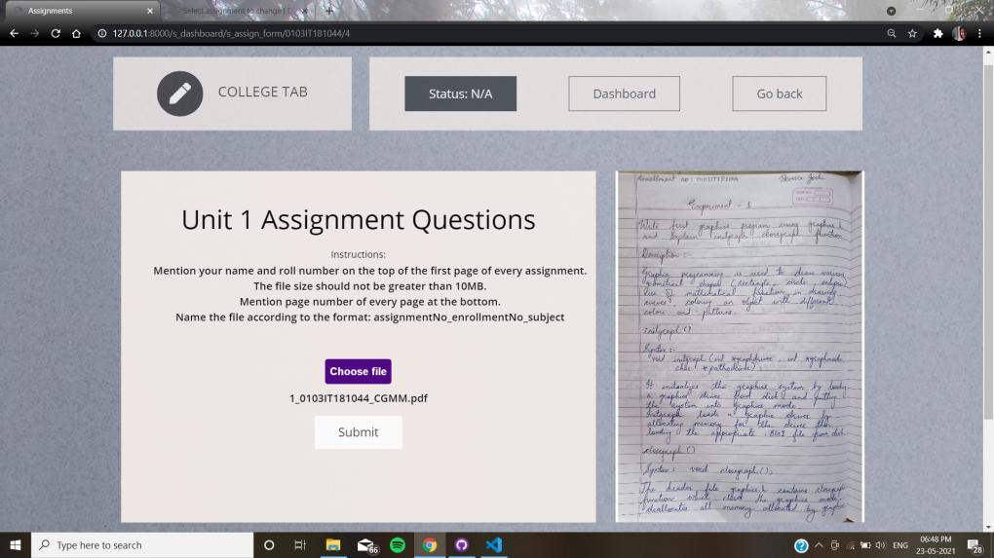

Slide 18
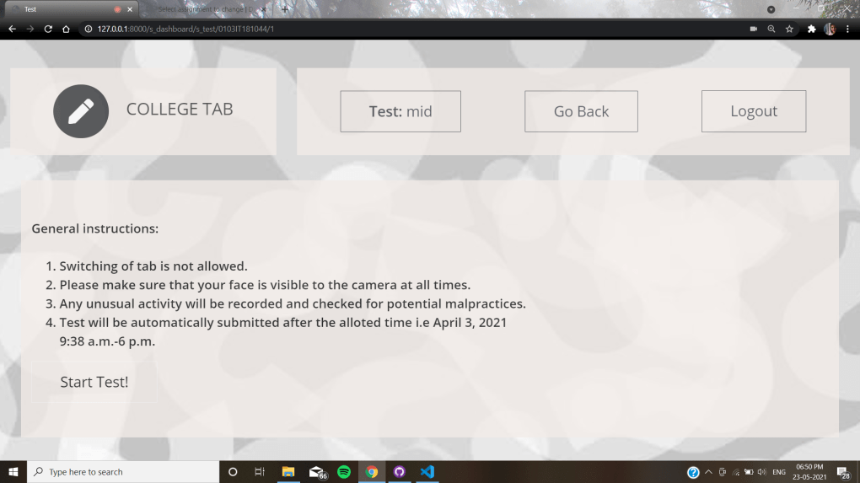

Slide 19
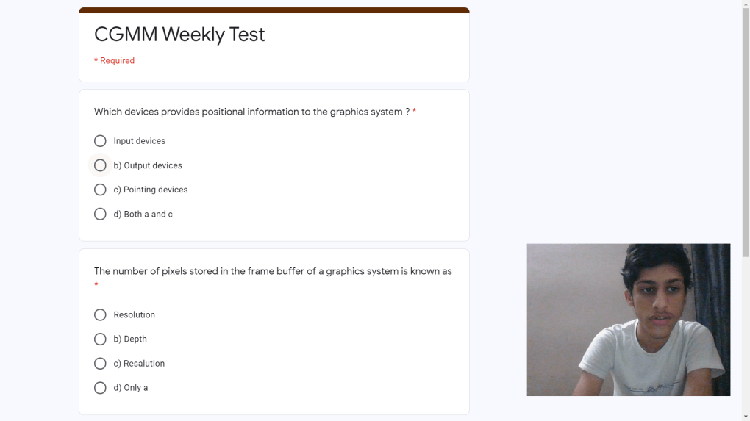

Slide 20
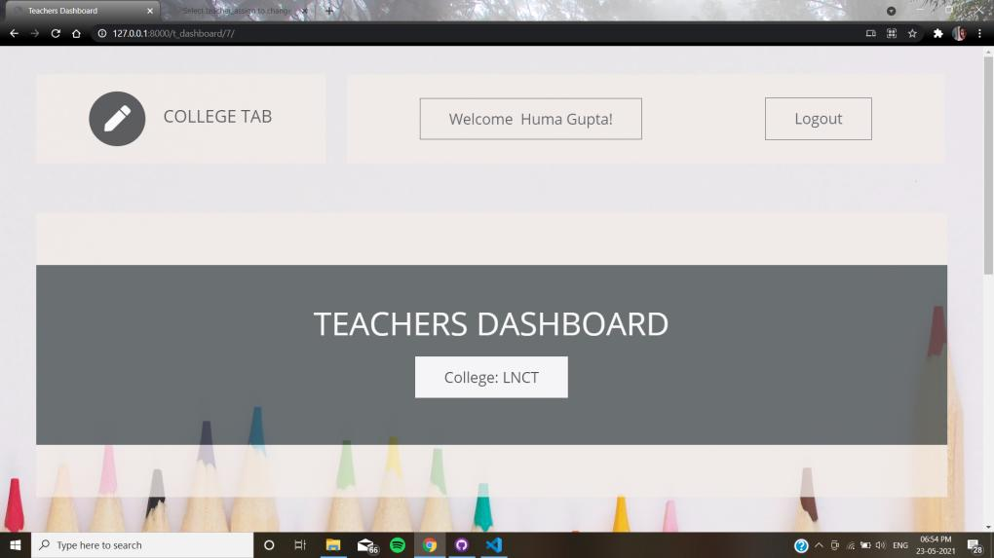

Slide 21
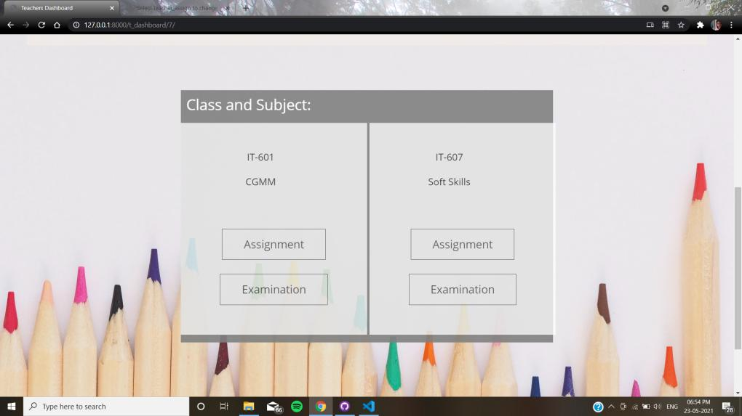

Slide 22
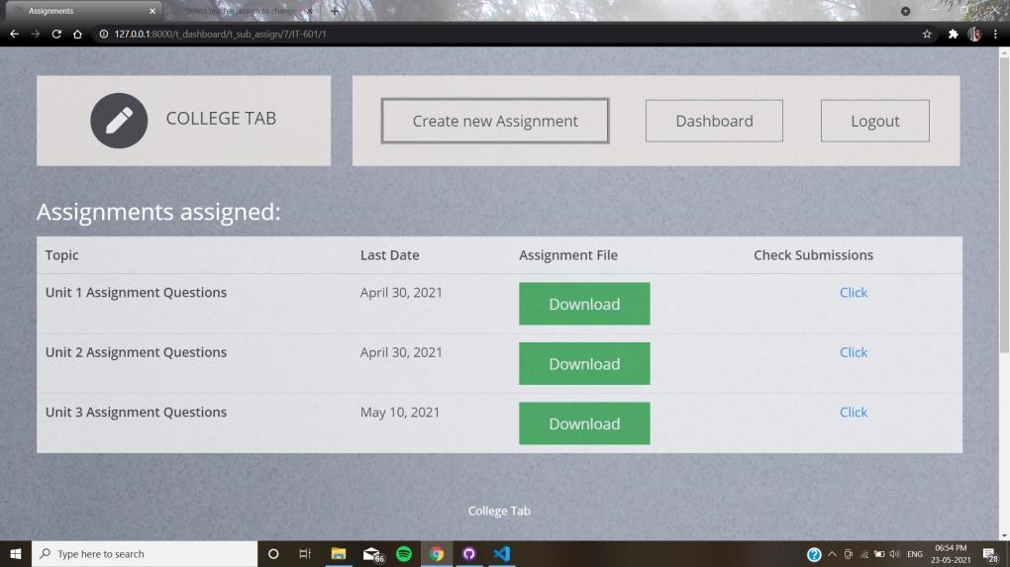

Slide 23
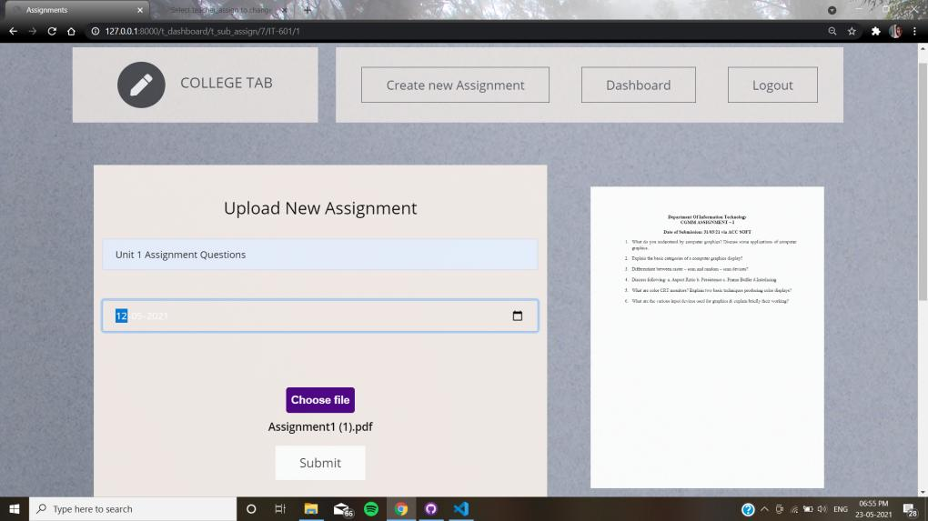

Slide 24
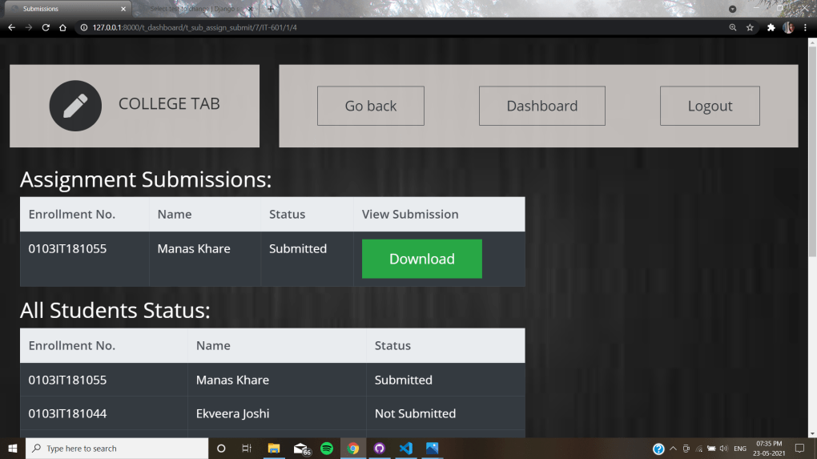

Slide 25
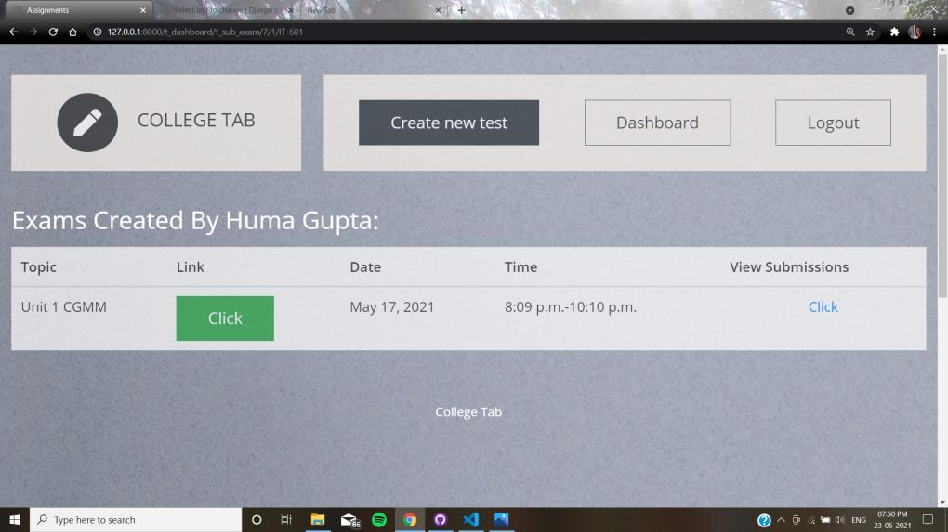

Slide 26
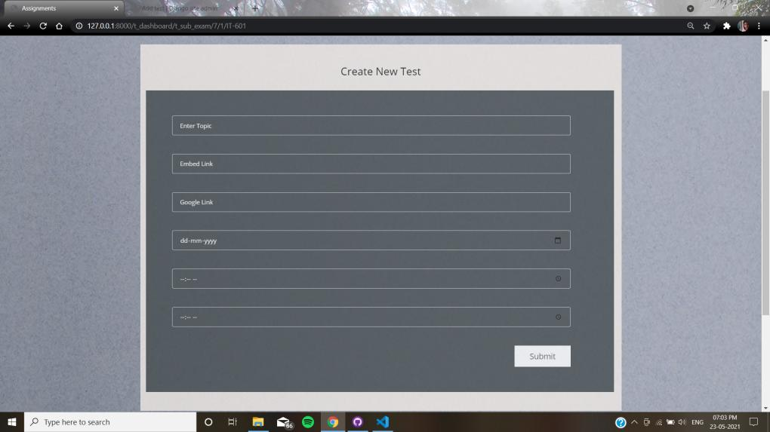

Slide 27
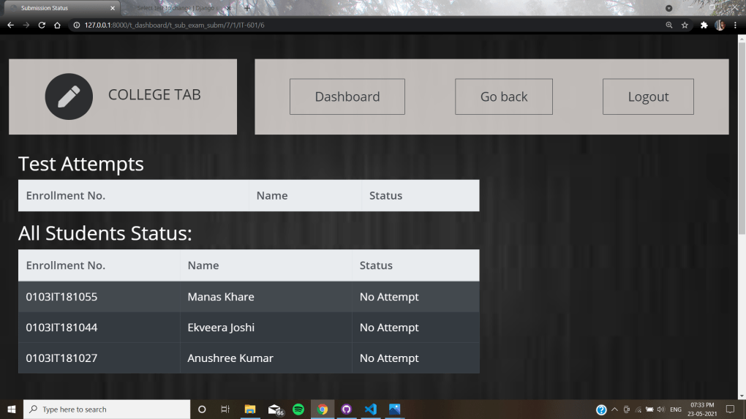

Slide 28
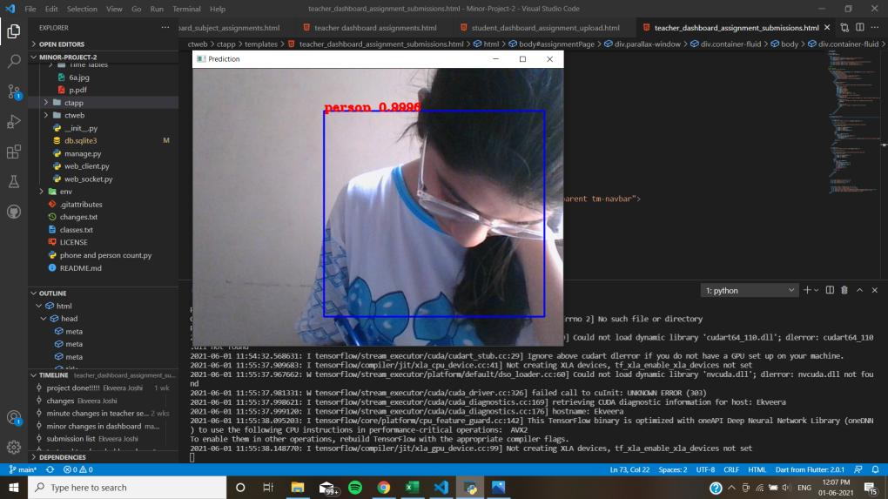

Slide 29
